Slide 1

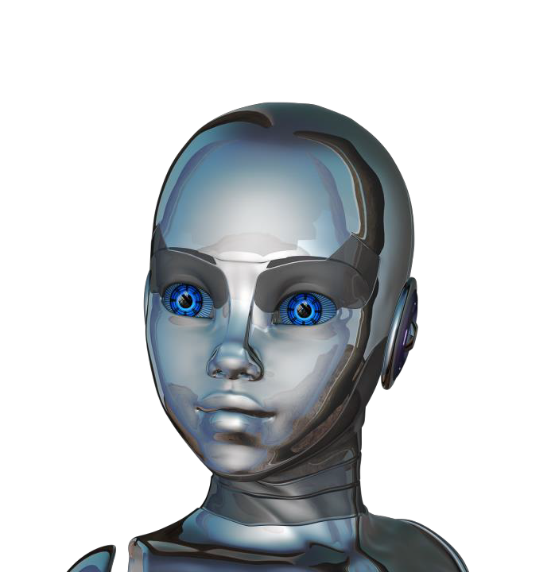

Discussion Objectives
Define “Artificial Intelligence” (AI),
“Machine Learning” (ML), and “Deep Learning” (DL)
Explain how DL helps solve classical ML limitations.
Explain the history of AI
Differentiate modern AI from prior AI.
Relate sample applications of AI.
1

Slide 2
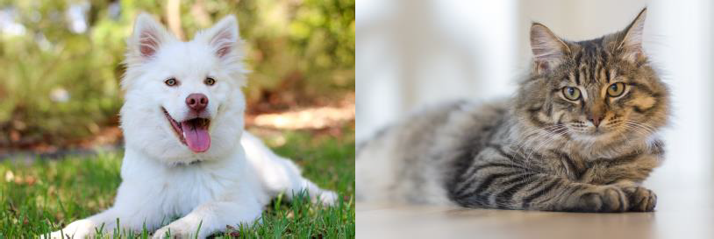
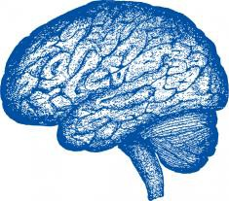
AI Breakthroughs
Image classification
Machine translation
“Je suis étudiant”
As of 2016, we have achieved near- human performance using the latest AI techniques.
“I am a student”
“Dog” “Cat”
As of 2015, computers can be trained
to perform better on this task than humans.
2

Slide 3
AI Is The New Electricity
“About 100 years ago, electricity transformed every major industry. AI has advanced to the point where it has the power to transform…every major sector in coming years.”
-Andrew Ng, Stanford University
Projected Revenue (in billions USD) Generated from AI, 2016-2020 (IDC)
50
38
25
13
0
2016
2020
3

Slide 4

6

Slide 5
Artificial Intelligence
“A branch of computer science dealing with the simulation of intelligent behavior in computers.” (Merriam-Webster)
“A program that can sense, reason, act, and adapt.” (Intel)
“Colloquially, the term ‘artificial intelligence’ is applied when a machine mimics ‘cognitive’ functions that humans associate with other human minds, such as ‘learning' and ‘problem solving’.” (Wikipedia)
5

Slide 6
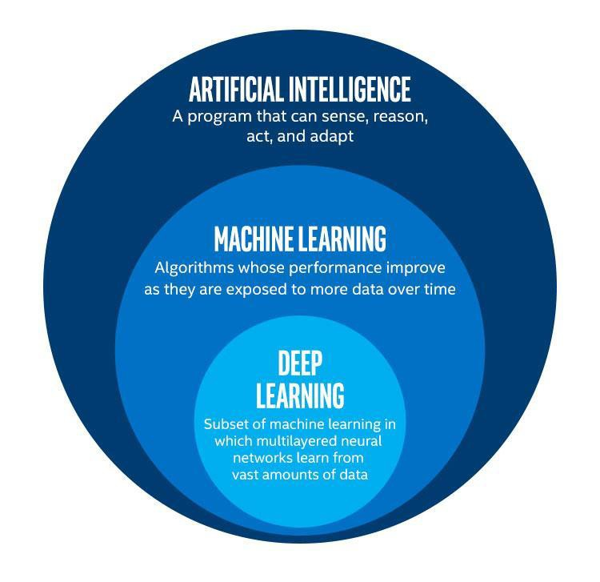
Definitions
Artificial Intelligence
Machine Learning
Deep Learning
6

Slide 7
Machine Learning
“The study and construction of programs that are not explicitly programmed, but learn patterns as they are exposed to more data over time.” (Intel)
7

Slide 8




Machine Learning
These programs learn from repeatedly seeing data,
rather than being explicitly programmed by humans.
SPAM?
Machine Learning Program
NOT SPAM?
Emails are labeled as spam vs. not
The more emails the program sees…
…the better it gets at classification
8

Slide 9

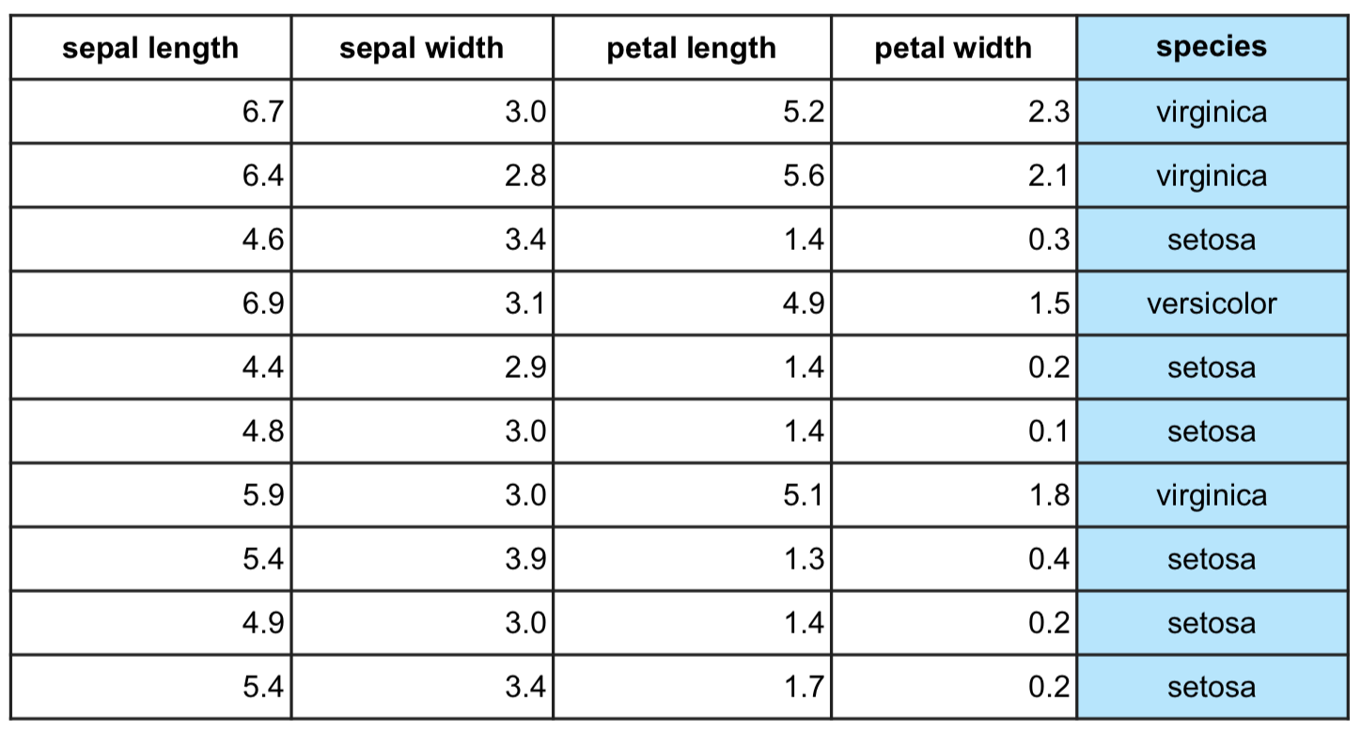
Machine Learning Terminology
This example is learning to classify a species from a set of measurement
features.
Features:
Attributes of the data.
Target:
Column to be predicted.
9

Slide 10
Two Main Types of Machine Learning
Dataset
Goal
Example
Supervised Learning
Make predictions
Fraud detection
Has a target column
Unsupervised
Learning
Does not have a
target column
Find structure
in the data
Customer
segmentation
10

Slide 11
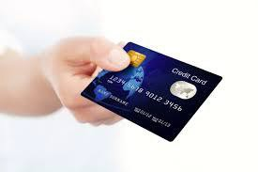
Machine Learning Example
Suppose you wanted to identify fraudulent credit card transactions.
You could define features to be:
Transaction time
Transaction amount
Transaction location
Category of purchase
The algorithm could learn what feature combinations suggest unusual activity.
11

Slide 12
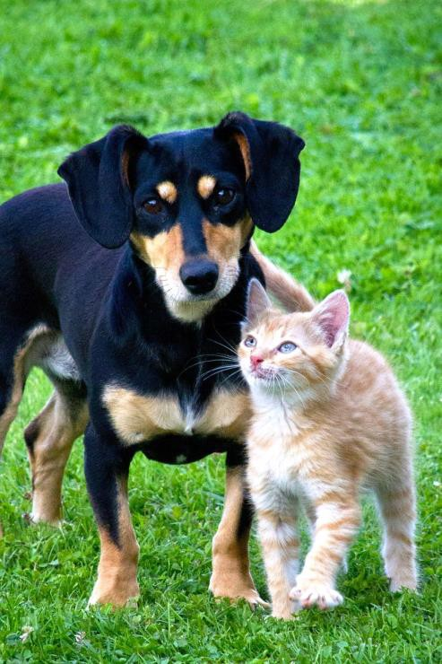
Machine Learning Limitations
Suppose you wanted to determine if an image is of a cat or a dog.
What features would you use?
This is where Deep Learning can come in.
Dog and cat recognition
12

Slide 13
Deep Learning
“Machine learning that involves using very complicated models called “deep neural networks”." (Intel)
Models determine best representation of original data; in classic machine learning, humans must do this.
13

Slide 14
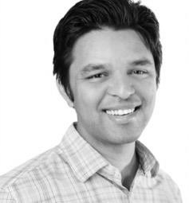




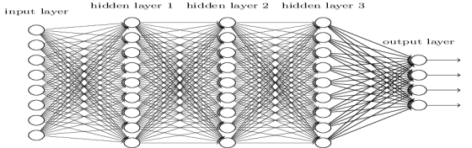

Deep Learning Example
Classic Machine Learning
Step 1: Determine features.
Step 2: Feed them through model.
Deep Learning
Steps 1 and 2 are combined into 1 step.
Machine Learning Classifier Algorithm
Feature Detection
“Arjun"
Neural Network
“Arjun"
14

Slide 15
17

Slide 16

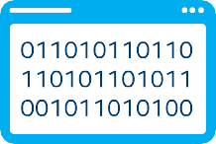
History of AI
AI has experienced several hype cycles, where it has oscillated between periods of excitement and disappointment.
Early algorithms
Expert systems
Neural networks
Machine learning
Deep learning
“AI Winter” late 1960s-1970s
“AI Winter” late 1980s-1990s
16

Slide 17

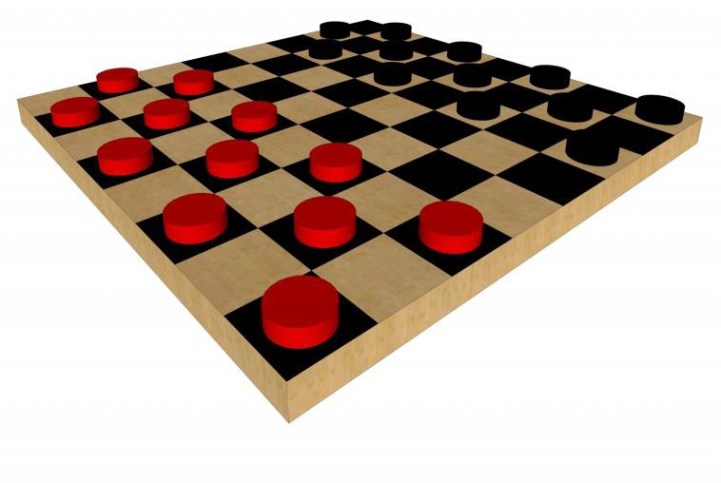
1950s: Early AI
1950: Alan Turing developed the Turing test to test a machines ability to exhibit intelligent behavior.
1956: Artificial Intelligence was accepted as a
field at the Dartmouth Conference.
1957: Frank Rosenblatt invented the perceptron algorithm. This was the precursor to modern neural networks.
1959: Arthur Samuel published an algorithm for a checkers program using machine learning.
17

Slide 18
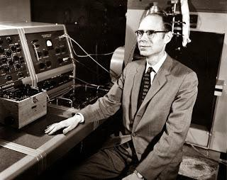
The First “AI Winter”
1966: ALPAC committee evaluated AI techniques for machine translation and determined there was little yield from the investment.
1969: Marvin Minsky published a book on the limitations of the Perceptron algorithm which slowed research in neural networks.
1973: The Lighthill report highlights AI’s failure to live up to promises.
The two reports led to cuts in government funding for AI research leading to the first “AI Winter.”
John R. Pierce, head of ALPAC
18

Slide 19
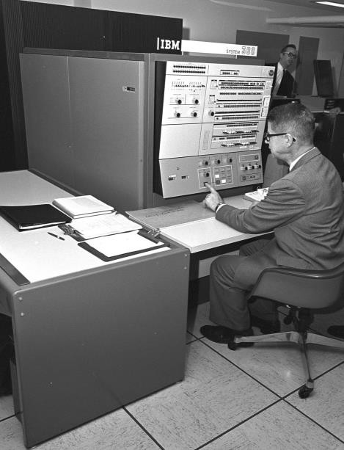
1980’s AI Boom
Expert Systems - systems with programmed
rules designed to mimic human experts.
Ran on mainframe computers with specialized programming languages (e.g. LISP).
Were the first widely-used AI technology, with two-thirds of "Fortune 500" companies using them at their peak.
1986: The “Backpropogation” algorithm is able to train multi-layer perceptrons leading to new successes and interest in neural network research.
Early expert systems machine
19

Slide 20
Another AI Winter (late 1980’s – early 1990s)
Expert systems’ progress on solving business problems slowed.
Expert systems began to be melded into software suites of general business applications (e.g. SAP, Oracle) that could run on PCs instead of mainframes.
Neural networks didn’t scale to large problems.
Interest in AI in business declined.
20

Slide 21

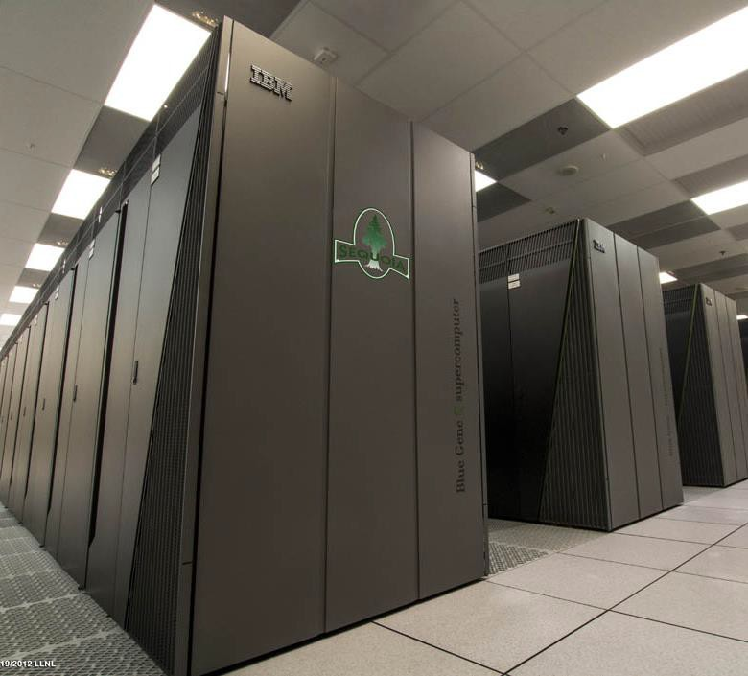
Late 1990’s to early 2000’s: Classical Machine Learning
Advancements in the SVM algorithm led to it
becoming the machine learning method of choice.
AI solutions had successes in speech recognition, medical diagnosis, robotics, and many other areas.
AI algorithms were integrated into larger systems
and became useful throughout industry.
The Deep Blue chess system beat world chess champion Garry Kasparov.
Google search engine launched using artificial intelligence technology.
IBM supercomputer
21

Slide 22
2006: Rise of Deep Learning
2006: Geoffrey Hinton publishes a paper on unsupervised pre-training that allowed deeper neural networks to be trained.
Neural networks are rebranded to deep learning.
2009: The ImageNet database of human-tagged images is presented at the CVPR conference.
2010: Algorithms compete on several visual recognition tasks at the first ImageNet competition.
22

Slide 23
25

Slide 24


Deep Learning Breakthroughs (2012 – Present)
In 2012, deep learning beats previous benchmark on the ImageNet competition.
In 2013, deep learning is used to
understand “conceptual meaning” of words.
In 2014, similar breakthroughs appeared in language translation.
These have led to advancements in Web Search, Document Search, Document Summarization, and Machine Translation.
“Hello”
“你好”
Google Translate
*Other names and brands may be claimed as the property of others.

Slide 25
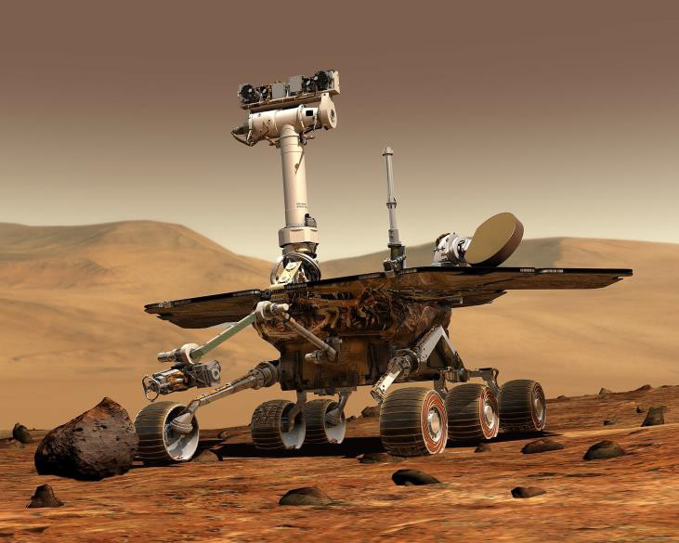
Deep Learning Breakthroughs (2012 – Present)
In 2014, computer vision algorithm can describe photos.
In 2015, Deep learning platform TensorFlow* is developed.
In 2016, DeepMind* AlphaGo, developed by Aja Huang, beats Go master Lee Se-dol.
*Other names and brands may be claimed as the property of others.

Slide 26

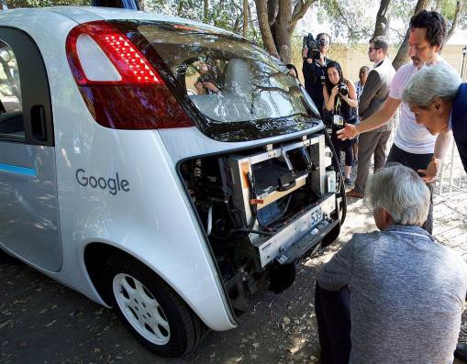

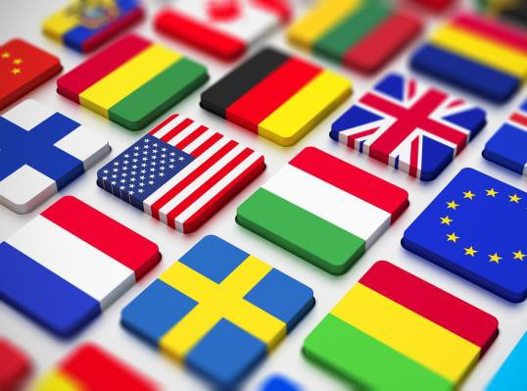
Modern AI (2012 – Present): Deep Learning Impact
Computer vision
Natural language
Self-driving cars: object detection
Healthcare: improved diagnosis
Communication: language translation

Slide 27









How Is This Era of AI Different?
Faster Computers
Bigger
Datasets
Neural
Nets
Cutting Edge Results in a Variety of Fields

Slide 28

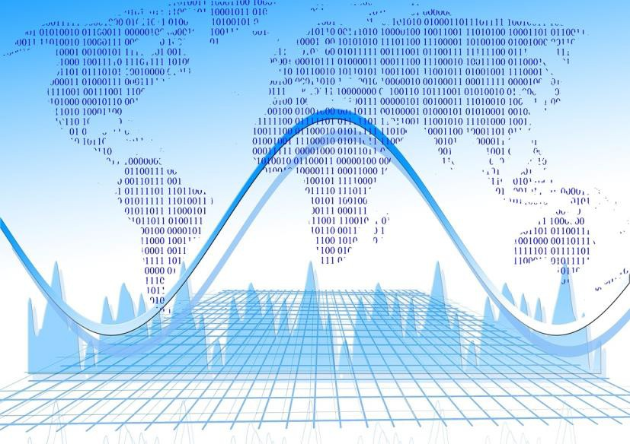
Other Modern AI Factors
Continued expansion of open source AI, especially in Python*, aiding machine learning and big data ecosystems.
Leading deep learning libraries open sourced, allowing further adoption by industry.
Open sourcing of large datasets of millions of labeled images, text datasets such as Wikipedia has also driven breakthroughs.
*Other names and brands may be claimed as the property of others.
30

Slide 29


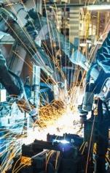
Transformative Changes
Health |  | Industrial
Enhanced Diagnostics Drug Discovery Patient Care Research Sensory Aids |  | Factory Automation Predictive Maintenance Precision Agriculture Field Automation
Source: Intel forecast

Slide 30

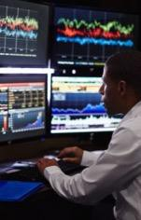

Transformative Changes
Finance |  | Energy
Algorithmic Trading Fraud Detection Research Personal Finance Risk Mitigation |  | Oil & Gas Exploration Smart Grid Operational Improvement Conservation
Source: Intel forecast

Slide 31

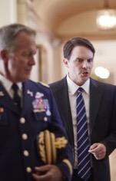
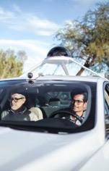
Transformative Changes
Government |  | Transport
Defense Data Insights Safety & Security Engagement Smarter Cities |  | Autonomous Cars Automated Trucking Aerospace Shipping Search & Rescue
Source: Intel forecast

Slide 32



Transformative Changes
Other
Advertising Education Gaming Professional & IT Services Telco/Media Sports
Source: Intel forecast

Slide 33
35

Slide 34
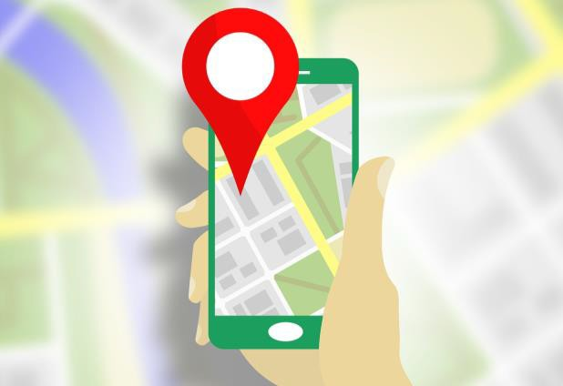
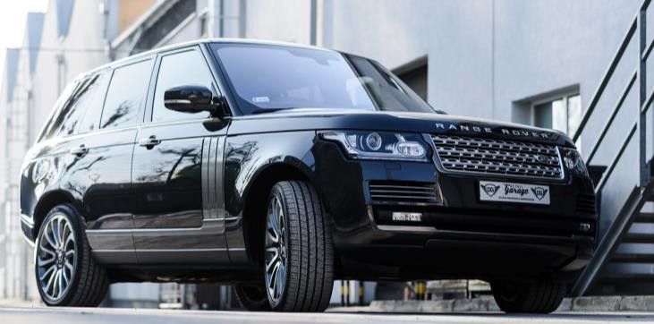
AI Omnipresence In Transportation
Navigation
Ride sharing
Uber & Lyft predict real-time demand using AI techniques, machine learning, deep learning.
Google & Waze find the fastest route, by processing traffic data.

Slide 35


AI Omnipresence In Social Media
Audience
Content
Facebook & Twitter use AI to decide what content to present in their feeds to different audiences.
Image recognition and sentiment analysis to ensure that content of the appropriate “mood” is being served.

Slide 36

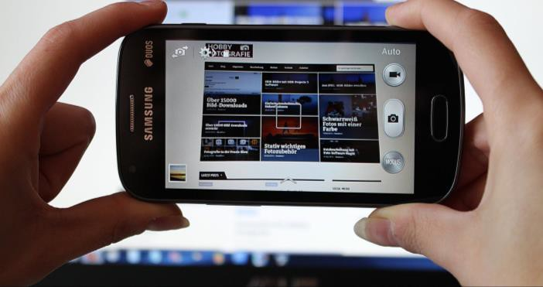
AI Omnipresence In Daily Life
Natural language
Object detection
We carry around powerful natural language processing algorithms in our phones/computers.
Cameras like Amazon DeepLens* or Google Clips* use object detection to determine when to take a photo.
*Other names and brands may be claimed as the property of others.
38

Slide 37

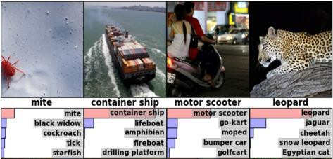
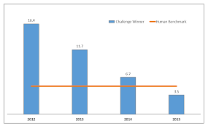
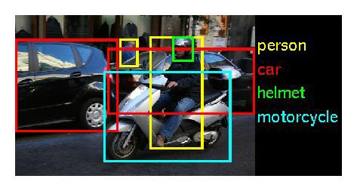
Latest Developments: Computer Vision
Deep Learning “proven” to work for image classification.
Models outperform humans on image classification.
Object detection models beat previous benchmarks.
2012
2015
2016

Slide 38
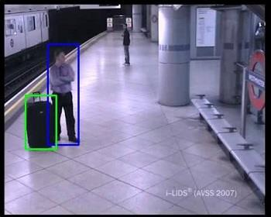
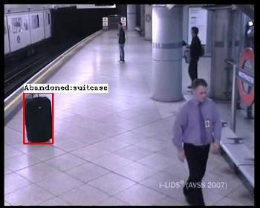
Application Area: Abandoned Baggage Detection
We can automatically detect when baggage has been left unattended, potentially saving lives.
This system relies on the
breakthroughs we discussed:
Cutting edge object detection.
Fast hardware on which to train the model (Intel® Xeon® processors in this case).
Abandoned baggage

Slide 39
Learning Objectives Recap
In this session, we worked to:
Define “Artificial Intelligence” (AI),
“Machine Learning” (ML), and “Deep Learning” (DL).
Explain how DL helps solve classical ML limitations.
Explain key historical developments,
and the “hype-AI winter cycle.”
Differentiate modern AI from prior AI.
Relate sample applications of AI.

Slide 40

42

